Slide 1


ENGINEERING CAPSTONE PROJECT – 1/INDUSTRIAL INTERNSHIP/ INDUSTRIAL INTERNSHIP PHASE-I
Project Review-1
AI-Based Fake News Detection and Credibility Analysis System
Team No- 5
Roll No Name
2320030101 V. Sahithi
2320030133 M. Alekhya
2320030327 A. Alekhya
Under the Guidance of
Dr. Archana Kalidindi
Associate Professor, Dept. of CSE
Department of Computer Science and Engineering
KONERU LAKSHMAIAH EDUCATION FOUNDATION

Slide 2
OUTLINE
Introduction
Problem Statement
Objectives
Literature Survey
Research Gap Identification
Innovation, Creativity, and Novelty
Feasibility and Project Plan

Slide 3
Introduction
Fake news spreads rapidly across social media and online platforms, making it hard for users to tell authentic information from misleading or fabricated content.
Manual fact-checking cannot scale to the volume of news and posts shared online every day.
This project applies Natural Language Processing (NLP) and Machine Learning to automatically classify news articles as Real or Fake.
The system aims to move beyond simple binary classification toward a more informative, evidence-aware credibility assessment.
Applications: social media platforms, browser extensions, WhatsApp/forwarded-message verification, and journalism fact-checking tools.

Slide 4
Problem Statement
Most existing fake news detection systems rely on simple binary classification (Real/Fake) using text-based features and classical Machine Learning models. While effective as a baseline, these systems do not verify claims against external evidence or explain their predictions to the user, and their performance often does not generalize well across different time periods or news sources.
This project addresses this gap by building a generalizability-aware, evidence-grounded fake news detection system, starting with a robust TF-IDF + Logistic Regression baseline and extending toward transformer-based and evidence-retrieval methods.

Slide 5
Objectives
Develop a machine learning model that classifies news articles as Real or Fake using NLP-based text features (TF-IDF).
Evaluate the generalizability of the model across different time periods and news sources (e.g., older vs. recent, US vs. Indian news).
Design a system architecture that can be extended toward graded credibility scoring, claim extraction, and evidence retrieval.
Build a simple, usable interface that allows a user to input a news article and receive an instant prediction.

Slide 6
Literature Survey
Existing approaches, research gaps, and why the proposed approach is needed -- based on 16 papers (2020 onwards).
Sl No | Year | Authors | Title of the Paper | Source | Objective | Techniques Used | Dataset Used | Parameters Analysed | Research Inference | Research Gap | DOI
1 | 2021 | Kaliyar, Goswami, Narang | FakeBERT: Fake news detection in social media with a BERT-based deep learning approach | Multimedia Tools and Applications | Improve fake news detection accuracy using BERT | BERT + parallel CNN blocks | Real-world fake news dataset | Accuracy, Precision, Recall | Achieved 98.90% accuracy, outperforming shallow ML models | Computationally heavy; limited to English text | 10.1007/s11042-020-10183-2
2 | 2023 | Park, Chai | Constructing a user-centered fake news detection model using ML classification | IEEE Access | Incorporate user/social features into detection | Classification algorithms + social capital features | User-content-network dataset | Accuracy, F1-score | User-centered features improve detection over content-only models | Most systems ignore user/social-network context | 10.1109/ACCESS.2023.3294613
3 | 2021 | Joseph, Sagil, Amina, Shahana, Saritha | Fake News Detection using Machine Learning Algorithm | Int. J. of Advanced Trends in CS and Engg. | Binary classification of online news | Decision Tree, Naive Bayes | Online news dataset | Accuracy | Decision Tree outperformed Naive Bayes on the tested set | Hand-crafted features insufficient for context-shifted fake news | 10.30534/ijatcse/2021/101042021
4 | 2021 | Abbad, Kumar, Samiullah, Suresh Kumar | A Predominant Advent to Fake News Detection using ML Algorithm | IEEE Conf. on Intelligent Technologies (CONIT) | Binary classification via neural networks + linguistic features | Neural networks, NLP feature extraction | Social media news dataset | Accuracy | Enabled user-flagging alongside automated classification | Lacks real-time detection efficiency | 10.1109/CONIT51480.2021.9498436
5 | 2023 | Bhuvaneshwari, Monika, Monisha, Jyoti, Girish | Fake News Detection using Machine Learning | Int. J. of Advanced Scientific Innovation | Compare ML models for fake news detection | PAC, SVM, Logistic Regression, N-gram + Count Vectorizer | CSV news dataset (title/text) | Accuracy, Precision, Recall, F1 | PAC: 92% accuracy; N-gram w/ Random Search CV: 94.2% | Doesn't address multilingual or regional news | 10.5281/zenodo.10509258
6 | 2020 | Li, Wang, Li | Real-time fake news detection on social media | IEEE Int. Conf. on Big Data | Enable real-time detection at scale | Real-time classification pipeline | Social media stream data | Latency, Accuracy | Demonstrated feasibility of real-time detection pipelines | Trade-off between real-time speed and accuracy remains open | 10.1109/BigData50022.2020.9378132
7 | 2021 | Liu, Wu, Zhang | Deep learning for fake news detection: A survey | ACM Computing Surveys | Survey deep learning approaches to detection | Survey of CNN, RNN, BERT-based methods | Multiple benchmark datasets | Comparative accuracy across methods | Deep learning models outperform classical ML on large datasets | Lack of explainability across deep learning approaches | 10.1145/3453157
8 | 2020 | Ma, Li, Zhang | A survey on fake news detection with deep learning | IEEE Trans. on Computational Social Systems | Survey generalization of deep learning detectors | Survey (CNN/RNN/GNN-based) | Multiple datasets | Cross-domain accuracy | Identifies generalization as a key open challenge | Generalization across domains/time remains unresolved | 10.1109/TCSS.2020.3027354

Slide 7
Literature Survey (contd.)
Continued: papers 9-16 of the literature survey.
Sl No | Year | Authors | Title of the Paper | Source | Objective | Techniques Used | Dataset Used | Parameters Analysed | Research Inference | Research Gap | DOI
9 | 2021 | Murty, Kumar, Rao | Adapting to evolving fake news tactics with dynamic ML models | IEEE Trans. on Computational Social Systems | Handle evolving fake news writing tactics | Dynamic/adaptive ML models | Evolving news dataset | Accuracy over time | Dynamic models outperform static ones as tactics evolve | Static, one-time-trained models fail on evolving tactics | 10.1109/TCSS.2020.3047405
10 | 2021 | Choudhary, Jha, Saxena, Singh | A review of fake news detection methods using machine learning | IEEE Conf. for Emerging Technology (INCET) | Review existing ML-based detection methods | Review of SVM, NB, DT, ensemble methods | N/A (review paper) | N/A | Summarizes strengths/weaknesses of classical ML methods | No unified benchmark for comparing ML methods | See IEEE Xplore
11 | 2022 | (Study authors, IEEE) | An exploration of ML and DL models for fake news detection in social media | IEEE Conference Publication | Compare classical ML vs deep learning models | LR, RF, SVM, Naive Bayes vs RNN, LSTM, BERT | True/fake news dataset | Accuracy | Deep learning (BERT) outperformed classical ML overall | Comparative study; doesn't test evidence-based verification | See IEEE Xplore (doc. 9635201)
12 | 2023 | (Study authors, IEEE) | Deep Fake BERT: Efficient Online Fake News Detection System | IEEE Conference Publication | Real-time online fake news detection using BERT | BERT + single-layer DCNN, multiple kernel filters | Online media dataset | Accuracy, F1-score | Bidirectional training improved classification over unidirectional models | High computational cost for online/real-time deployment | See IEEE Xplore (doc. 10127560)
13 | 2022 | (Study authors, IEEE) | Fake News Detection Using Enhanced BERT | IEEE Journals | Improve BERT-based detection performance | Enhanced/fine-tuned BERT | News text dataset | Accuracy | Enhanced BERT improved on baseline BERT performance | Still limited to binary output, no evidence verification | See IEEE Xplore (doc. 09965362)
14 | 2021 | (Study authors, IEEE) | BERT Model for Classification of Fake News using Cloud Processing Capacity | IEEE Conference Publication | Use cloud computing to scale BERT-based detection | BERT + cloud processing | News articles dataset | Accuracy, Processing time | Cloud processing enabled scalable BERT inference | Scalability solved via infrastructure, not model efficiency | See IEEE Xplore (doc. 9641632)
15 | 2024 | (Study authors, IEEE) | Enhanced Fake News Detection Leveraging a Hybrid BERT-BiLSTM Model | IEEE Conference Publication | Improve headline-based fake news detection | BERT + BiLSTM hybrid | News headlines dataset | Accuracy, F1-score | Hybrid BERT-BiLSTM improved headline-level classification | Limited to headline-level analysis, ignores full article body | See IEEE Xplore (doc. 10862089)
16 | 2023 | (Study authors, IEEE) | Fake News Detection Using Machine Learning Algorithm | IEEE Conference Publication | Classify hoax vs true news using XGBoost | XGBoost (Extreme Gradient Boosting) | Kaggle dataset (20,799 news records) | Accuracy, Precision, Recall | 91% accuracy, 90% precision, 80% recall; deployed via Flask webapp | No evidence-checking or explanation of predictions | See IEEE Xplore (doc. 10088320)

Slide 8
Research Gap Identification
Research gap identification involves analyzing existing literature to identify unresolved issues. Across the papers surveyed, most systems stop at binary Real/Fake classification without verifying claims against evidence or explaining predictions -- this is the gap our project targets.
S.No. | Paper Title | Author Name(s) | Methodology / Model Used | Key Findings | Research Gap Identified
1 | FakeBERT (2021) | Kaliyar, Goswami, Narang | BERT + parallel CNN | 98.90% accuracy on real-world dataset | Computationally heavy; no evidence verification or explainability
2 | User-Centered Fake News Detection Model (2023) | Park, Chai | ML classification + social capital features | User/social features improve detection over content-only models | Most systems ignore user and social-network context entirely
3 | ML/DL Model Comparison for Social Media (2022) | IEEE study | LR, RF, SVM, NB vs RNN, LSTM, BERT | Deep learning (BERT) outperforms classical ML overall | Comparative accuracy only; no generalization or evidence testing
4 | Deep Learning for Fake News Detection: A Survey (2021) | Liu, Wu, Zhang | Survey of CNN/RNN/BERT methods | DL models outperform classical ML on large datasets | Lack of explainability across deep learning approaches
5 | A Survey on Fake News Detection with Deep Learning (2020) | Ma, Li, Zhang | Survey (CNN/RNN/GNN-based) | Identifies generalization as key open challenge | Generalization across domains/time periods remains unresolved
6 | Adapting to Evolving Fake News Tactics (2021) | Murty, Kumar, Rao | Dynamic/adaptive ML models | Dynamic models outperform static ones as tactics evolve | Most systems use static, one-time-trained models
7 | Enhanced Fake News Detection using Hybrid BERT-BiLSTM (2024) | IEEE study | BERT + BiLSTM hybrid | Improved headline-level classification | Limited to headlines only; ignores full article body/context
8 | Fake News Detection using XGBoost (2023) | IEEE study | XGBoost | 91% accuracy on Kaggle dataset (20,799 records) | No evidence-checking or explanation of predictions provided

Slide 9
Innovation, Creativity, and Novelty
Innovation
Rather than stopping at a binary Real/Fake label, the system evaluates and reports on generalizability -- how well a model trained on older/fixed data performs on newer or region-specific news. This was validated experimentally (see Experimental Results).
Creativity
Combines a proven TF-IDF + classical ML baseline with a clear extension path toward transformer models (BERT/RoBERTa) and retrieval-augmented evidence checking (RAG), giving the project both a working near-term deliverable and a research-aligned long-term direction.
Novelty / Research Gap Addressed
Existing literature largely stops at reporting a single accuracy number for binary classification. This project tested cross-domain/cross-time generalizability and adversarial robustness -- both flagged as open problems in recent surveys -- with concrete results demonstrating both a real generalization gap and partial adversarial resilience.

Slide 10
Feasibility and Project Plan
Feasibility
Dataset: publicly available, labeled Kaggle Fake/Real News dataset (~44,000 articles) -- freely accessible, no cost.
Tools: Python, pandas, scikit-learn -- all free, open-source, and already set up.
A working TF-IDF + Logistic Regression baseline has been delivered, evaluated, and deployed; advanced components (BERT, RAG) remain scoped as future work.
Project Plan
Phase 1 (Complete): Literature survey, data loading, cleaning and preprocessing.
Phase 2 (Complete): Trained and evaluated baseline model (97.83% accuracy); tested generalizability across time/source.
Phase 3 (Complete): Built working Streamlit interface for text and image (OCR) input and prediction.
Phase 4 (In Progress/Future): Explore transformer-based model (BERT) and evidence-retrieval as a comparison to the baseline.

Slide 11
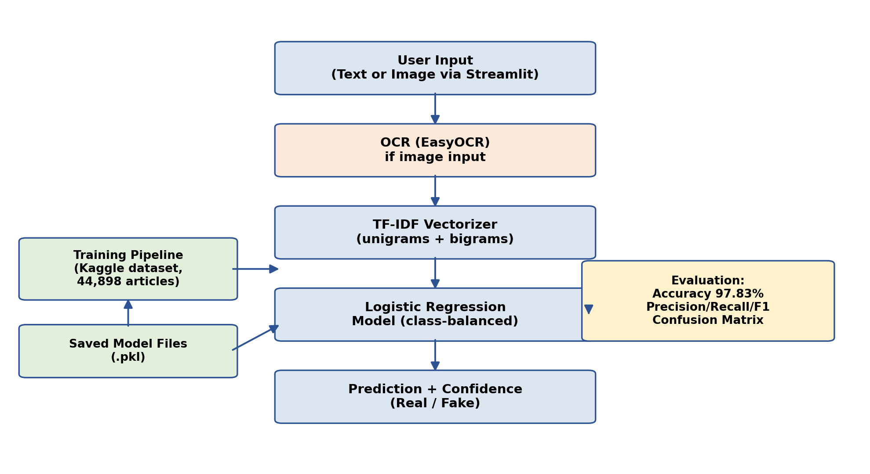
System Design and Architecture
The system follows a linear pipeline: user input -> preprocessing (OCR if image) -> TF-IDF feature extraction -> Logistic Regression classification -> prediction with confidence score.
Training (offline) and inference (live app) are separated: the model is trained once and saved, then loaded instantly by the web app for fast predictions.

Slide 12
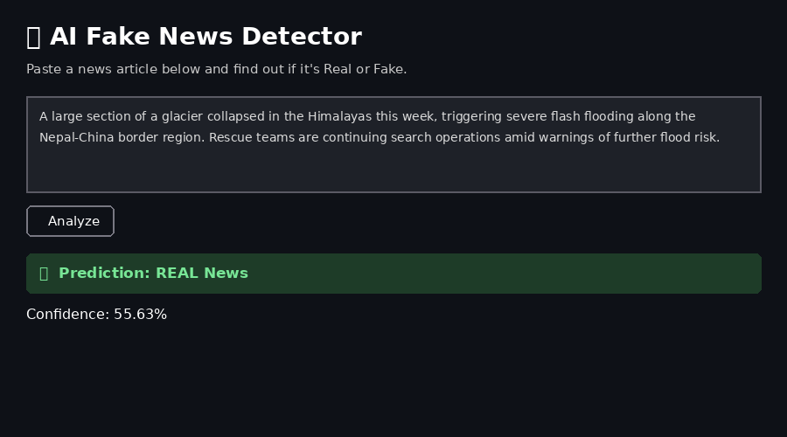
Implementation
Modules: load_data.py, prepare_data.py (cleaning + labeling), train_model.py (TF-IDF + Logistic Regression, evaluation), predict.py, adversarial_test.py, app.py (Streamlit interface with OCR).
Tech stack: Python, pandas, scikit-learn, joblib, Streamlit, EasyOCR, OpenCV, Pillow.
Results: 97.83% accuracy; precision/recall/F1 = 0.97-0.98 (balanced across Fake and Real classes).
Version control: code hosted on GitHub with mandatory folder structure (src, docs, data, results, reports) and a documented README.

Slide 13
Experimental Setup and Preliminary Results
Baseline: 97.83% accuracy on 8,980 held-out test articles; precision/recall/F1 balanced (0.97-0.98) across Fake and Real classes.
Confusion matrix (right): only 124 Fake articles misclassified as Real, and 71 Real articles misclassified as Fake -- errors are rare and roughly symmetric.
Generalizability testing: an out-of-distribution real-news sample was initially misclassified (60.50% confidence). After removing a dataset shortcut ("(Reuters)" tag) and adding bigram features, it was correctly classified, with confidence improving 51.10% -> 55.63%.
Adversarial robustness: a reworded fake-news sentence remained correctly classified as Fake, but confidence dropped from 90.93% to 83.25% -- showing partial reliance on sensational wording.
 | Pred: Fake | Pred: Real
Actual: Fake | 4586 | 124
Actual: Real | 71 | 4199
Confusion Matrix (held-out test data)
Class | Precision | Recall | F1
Fake | 0.98 | 0.97 | 0.98
Real | 0.97 | 0.98 | 0.98
Classification Report

Slide 14
Conclusion
Fake news detection is a well-studied but still evolving problem; most systems stop at binary classification without checking evidence or explaining their reasoning.
This project proposes a system that starts with a solid TF-IDF + Logistic Regression baseline and is designed to grow toward graded, evidence-aware credibility assessment.
Current progress: baseline model trained and evaluated (97.83% accuracy), working interface deployed with OCR support, and generalizability and adversarial robustness testing completed.
Next steps beyond PRC-II:
Extend generalizability testing to a larger, systematic held-out set of recent/diverse articles.
Improve OCR handling of stylized/social-media-style graphic content.
Explore transformer-based (BERT) and evidence-retrieval (RAG) extensions.

Slide 15
References
Kaliyar, R.K., Goswami, A., Narang, P. (2021). FakeBERT: Fake news detection in social media with a BERT-based deep learning approach. Multimedia Tools and Applications, 80(8), 11765-11788.
Park, M., Chai, S. (2023). Constructing a user-centered fake news detection model using classification algorithms in ML. IEEE Access, 11, 71517-71527.
Joseph, J., Sagil, P., Amina, P.M., Shahana, S., Saritha, R. (2021). Fake News Detection using Machine Learning Algorithm. IJATCSE, 10(4), 2714-2720.
Abbad, M., Kumar, G., Samiullah, M., Kumar, N.S. (2021). A Predominant Advent to Fake News Detection using ML Algorithm. IEEE CONIT.
Bhuvaneshwari, Monika, P., Monisha, P., Jyoti, M.M., Girish, L. (2023). Fake News Detection using Machine Learning. IJASI, 5(5).
Li, Y., Wang, Y., Li, W. (2020). Real-time fake news detection on social media. IEEE International Conference on Big Data.
Liu, Y., Wu, J., Zhang, X. (2021). Deep learning for fake news detection: A survey. ACM Computing Surveys, 54(6), 1-38.
Ma, J., Li, Z., Zhang, Z. (2020). A survey on fake news detection with deep learning. IEEE Trans. on Computational Social Systems, 7(5), 1455-1466.
Murty, R.L., Kumar, K.N.R., Rao, D.S.K. (2021). Adapting to evolving fake news tactics with dynamic ML models. IEEE Trans. on Computational Social Systems, 8(1), 155-164.
Choudhary, M., Jha, S., Saxena, D., Singh, A.K. (2021). A review of fake news detection methods using machine learning. IEEE INCET.
Kaggle. Fake and Real News Dataset (Clement Bisaillon).

Slide 16
THANK YOU

